Slide 1


BC2406 Analytics I: Visual & Predictive Techniques
New flagship product for EIU using machine learning and non-machine learning in predicting ESG
Wong Wei Jun (U1910841D)
Lim Qing Rui (U2010816G)
Lim Zi Hui (U1911430H)
Tan Jin Xuan (U2010840L)
Tan Jin Xuan
Prepared for: Prof. Liu Peng

Slide 2
Table of Contents
Tan Jin Xuan
01.
Introduction
Project Objectives
04.
Machine Learning
Methodology
02.
Data Preparation
05.
Recommendations
03.
Non-Machine Learning
Methodology

Slide 3

Introduction
Tan Jin Xuan
ESG Score
3

Slide 4
Tan Jin Xuan
What is ESG ?
Environmental Social and Governance
A set of standard that are being used to judge the entity’s performance in term of their sustainability in 3 primary factors of Environment, Social and Governance
Environment
Social
Governance

Slide 5

Tan Jin Xuan
ESG assets
Over US $ 53 trillion in 2025
Increase 15% year on year
Notes:
Double the prior year

Slide 6



Tan Jin Xuan
Why we choose ESG Score?
Potential market
More than 100 countries are focusing a lot of attention
Better decision
Better value add to the report that provides to investors
Performance indicator
Measure how the countries respond unexpected events

Slide 7
Project Objectives
Tan Jin Xuan
7

Slide 8




Tan Jin Xuan
Project feasibility
Availability of Data | Predictive need | Lack of perfect knowledge | Availability of data for train and test set
Able to access sufficient ESG data | No benchmark on indicator the factors that impact the ESG Score | Lack of prediction of variable to create the predictive model | Sufficient data to create predictive models and analysis

Slide 9
Predictive Models
Tan Jin Xuan
Non-Machine Learning
Linear Regression
CART
Mean, median mode of ESG variables with region
Support Vector Machine
Machine Learning

Slide 10
Tan Jin Xuan
Analytic comparison metrics
RMSE
MAPE
Statistical and Variable Significance
Standard deviations of the residual between the actual result and the predicted results
Average absolute percentage errors of forecasts
Determine the significant variables in determining ESG Scores

Slide 11
Data Preparation
Lim Zi Hui
Data Sources
Data Cleaning and Splitting
11

Slide 12


Lim Zi Hui
Data Sources
Internationally recognized entity
Works closely with international statistical community (e.g. UN and OECD)
Assembles, analyse, and distribute data sets online publicly
67 ESG variables over 193 countries
Monitors local and international regulatory trends through risk indexes (e.g. Global Corruption Index (GCI) and ESG)
2020 ESG scores over 176 countries

Slide 13
Lim Zi Hui
Data Cleaning and Splitting
Environmental | Social | Governance
CO2 Emissions | Control of Corruption | Voice and Accountability
Nitrous Oxide Emissions | Life Expectancy at Birth | Political Stability and Absence of Violence / Terrorism
 | Fertility Rate | Government Effectiveness
 |  | Regulatory Quality
 |  | Rule of Law
20 – 30 – 50
In accordance with ratio used by GRP to compute ESG scores

Slide 14
Lim Zi Hui
Data Combination and Cleaning
“ESG_Variables”
“ESGIndex2020”
“GDPgrowth”
“ESGdata2019”
1
Replaced “..” with “NA”, renamed variables
2
Kept common countries throughout all 3 data sets
3
Replaced missing values (352) with mean values
4
Kept only 2019 data

Slide 15
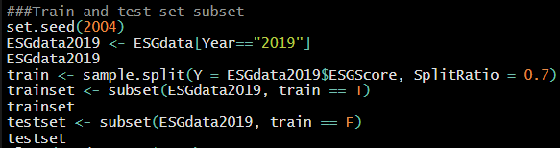
Lim Zi Hui
Data Splitting
Generation of pseudorandom numbers that mimic the properties of independent generations of a uniform distribution
70 – 30 split ratio for train and test sets
Train set: Data used to create the model
Test set: Data used to evaluate the performance of the model

Slide 16
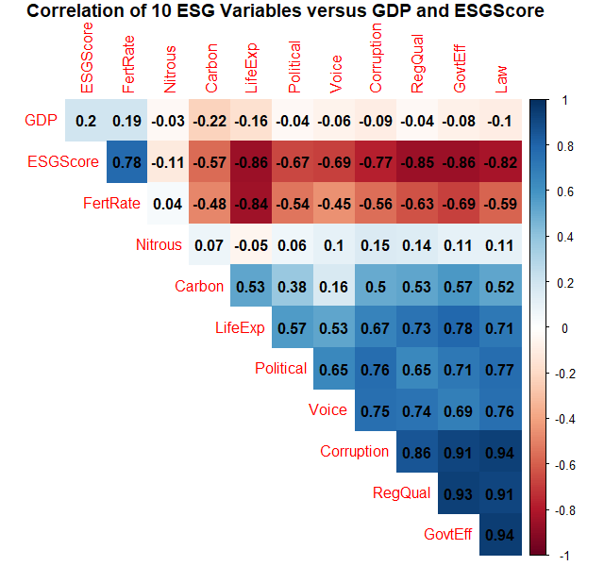
Lim Zi Hui
Data Exploration
1
Law and Government Effectiveness are positively correlated
Corruption, Regulatory Quality, Government Effectiveness, Law, are highly positively inter-correlated
2
3
Fertility Rate and Life Expectancy are highly negatively correlated
4
Fertility Rate and ESG Score are highly positively correlated
Life Expectancy, Regulatory Quality, Government Effectiveness, Law, are highly negatively correlated to ESG Score
5

Slide 17
Non-Machine Learning Methodologies
Lim Zi Hui
Descriptive
Predictive
17

Slide 18

Descriptive Analysis
Lim Zi Hui

Slide 19
Lim Zi Hui
Box Plots for Each Variable
Minimum
First Quartile
Median
Third Quartile
Maximum
Mean
Distribution of data
Skewness of data
Identification of outliers

Slide 20
Lim Zi Hui
Box Plots for Each Variable
Variable | Skewness | Outliers
Rule of Law | Positive | No
Voice and Accountability | Negative | No
Political Stability and Absence of Violence | Negative | Yes
Government Effectiveness | Positive | No
Regulatory Quality | Positive | No
Control of Corruption | Positive | No
Life Expectancy at Birth | Negative | No
CO2 Emissions | Positive | Yes
Nitrous Oxide Emissions | Positive | Yes
Fertility Rate | Positive | Yes
GDP | Positive | Yes

Slide 21
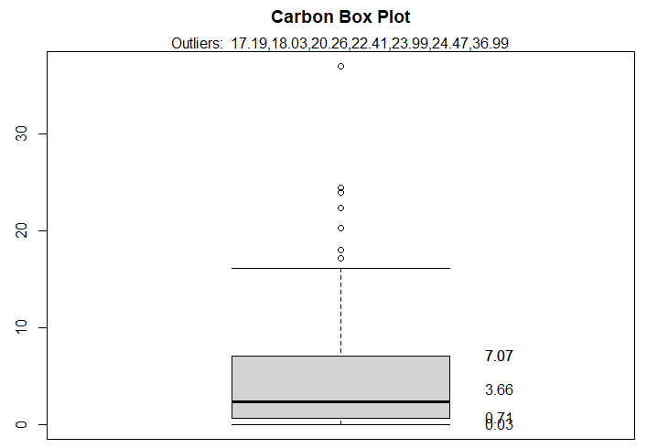
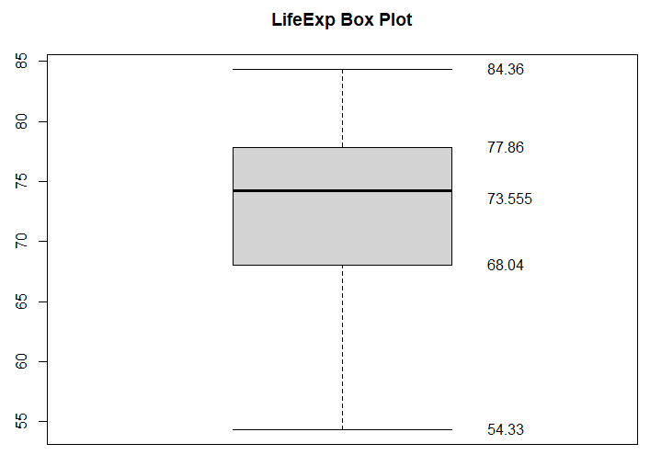
Lim Zi Hui
Box Plots for Each Variable
Positively skewed
Presence of outliers influence the mean
Small variability of data
Negatively skewed
Small variability of data

Slide 22


Lim Zi Hui
Evaluation
Simple visualization tool
Useful for comparing the performance of different countries for each variable
No meaningful comparisons for the performance against each variable
Purely descriptive, do not provide precision, accuracy and recall
Unable to obtain predicted data based on test sets
Stability of model is dependent on outliers

Slide 23

Predictive Analysis
Lim Zi Hui

Slide 24
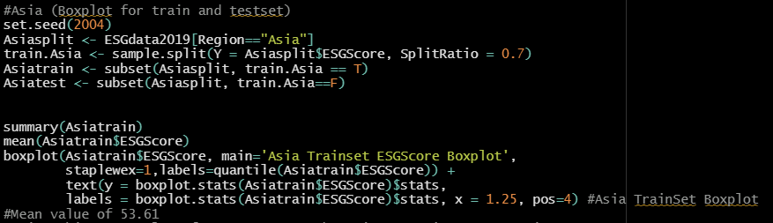
Lim Zi Hui
Predicting Regional ESG Score
Mean computed based on 70% of the data and served as the predicted value of remaining 30%
Box plots generated to understand the variability of ESG scores between different countries in the same region

Slide 25
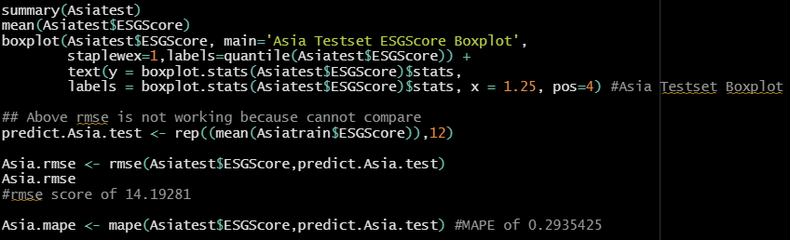
Lim Zi Hui
Predicting Regional ESG Score
Prediction of RMSE and MAPE value using the “MLmetrics” package in R
Root Mean Square Error (RMSE) and Mean Absolute Percentage Error (MAPE) computed to measure the accuracy of the model

Slide 26
Lim Zi Hui
Predicting Regional ESG Score
Region | RMSE | MAPE
Asia | 14.19 | 0.2935
Africa | 7.67 | 0.0933
Europe | 12.81 | 0.4215
North America | 15.09 | 0.1875
Oceania | 23.51 | 0.8671
South America | 8.55 | 0.1761
Average | 13.64 | 0.3398
Huge variability in RMSE of the different regions
High MAPE for Europe and Oceania

Slide 27
Lim Zi Hui
Evaluation
Simple sample mean prediction method to find out trends and predict outcomes about the larger population
Can be used to obtain the ESG Scores of countries that do not have available ESG Scores
Unreliable, as countries may differ greatly from each other in terms of their ESG factors
High MAPE suggests possibility of model overfitting, or that data was skewed
Huge variability in RMSE suggests that box plots should not be substituted as a predictive model
Unable to determine statistical and variable significance

Slide 28
Machine-Learning Methodologies
Wong Wei Jun
Linear Regression
CART
SVM
28

Slide 29
Linear Regression
Wong Wei Jun

Slide 30
Linear Regression
Wong Wei Jun
Dependent Variables | Independent Variables
ESG Score (Continuous) | Rule of Law Voice & Accountability Political stability & Absence of violence Regulatory Quality Government Effectiveness Control of Corruption Life expectancy at Birth CO2 Emissions Nitrous Oxide Emissions Fertility Rate
Linear regression is used to predict ESG Score based on the 10 independent variables
Linear Regression is chosen because ESG score is a continuous variable

Slide 31
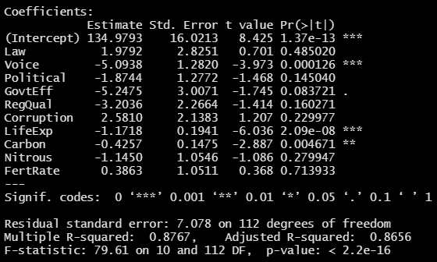
Linear Regression
Wong Wei Jun
4 Statistically significant variables
6 Statistically insignificant variables

Slide 32

Linear Regression
Wong Wei Jun
ESG Score = 71.95897 + 0.50107(Law) – 3.70967(Voice) – 1.22374(Political) – 3.01566(GovtEff) – 3.20658(RegQual) – 0.01605(Corruption) – 0.45347(LifeExp) – 0.35267(Carbon) – 1.33539(Nitrous) – 3.07652(FertRate)
All variables are used to construct the model to maintain the 20%, 30% and 50% composition of ESG variable
Indicating an 87.67% of the variability of the outcome data that can be explained by the linear regression model
After adjusting for the number of predictors in the model, adjusted R-squared is at 86.56%. Indicating that the correlation is reliable

Slide 33
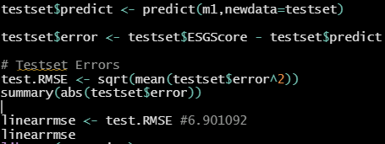
Linear Regression
Wong Wei Jun
Testing on accuracy of linear regression model
Function in R to predict values on the input data
Steps to conduct the RMSE testing without the use of “MLmetrics” package in R
Using MLmetrics package
Prediction of MAPE value using the “MLmetrics” package in R
Metrics | Value
RMSE | 6.901092
MAPE | 0.1381269 / 13.81%

Slide 34
CART
Wong Wei Jun
Classification and Regression Tree

Slide 35
Wong Wei Jun
CART uses partitioning approach to segregate variables according to the importance and weightage in affecting the dependent variable
Minimum split based on the 1 Standard Error (1 SE) approach to obtain the best trees to display
CART Models
Replace null value with mean imputation
Null values with surrogate splits

Slide 36
Wong Wei Jun
CART model (Replace null value with mean imputation)
‘Anova’ for regression tree
Minsplit =2 with cp = 0 ensures R grows the tree to its maximum

Slide 37
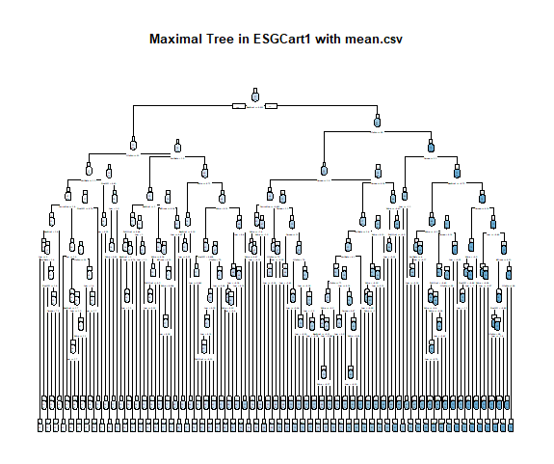
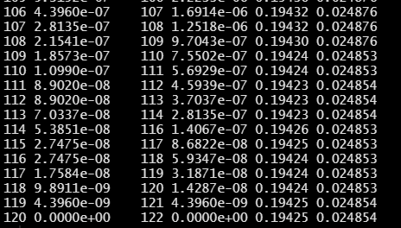
Wong Wei Jun
CART model (Replace null value with mean imputation)
Maximum tree has 122 splits
Notes:
The unpruned tree results in overplotting and is undesirable as it does not show statistical significance

Slide 38
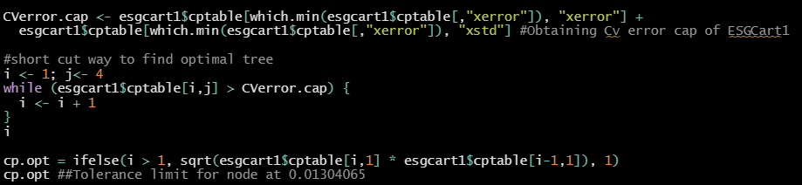
Wong Wei Jun
CART model (Replace null value with mean imputation)
Pruning to optimal tree
Compute minimum CV Error + 1 SE
Optimal CP region whose CV error is just below Cverror.cap
Geometric mean of the two identified CP value in the optimal region
Notes:
First two line computes the minimum CV error + 1 SE in the maximal tree. While the middle portion are

Slide 39
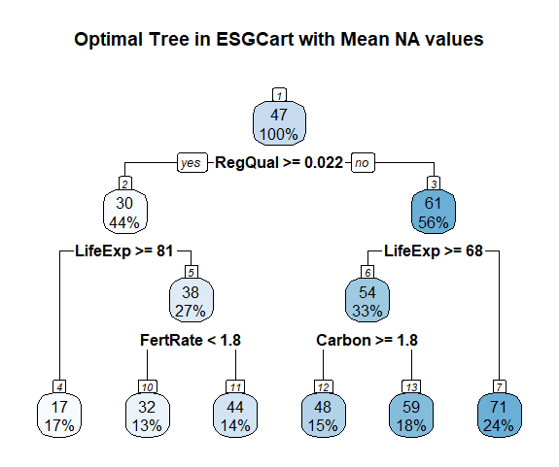
Wong Wei Jun
CART model (Replace null value with mean imputation)
Decision variables are RegQual, LifeExp, FertRate & Carbon

Slide 40
Wong Wei Jun
CART model (Replace null value with mean imputation)
The following variables are significant variables in predicting ESG Scores

Slide 41
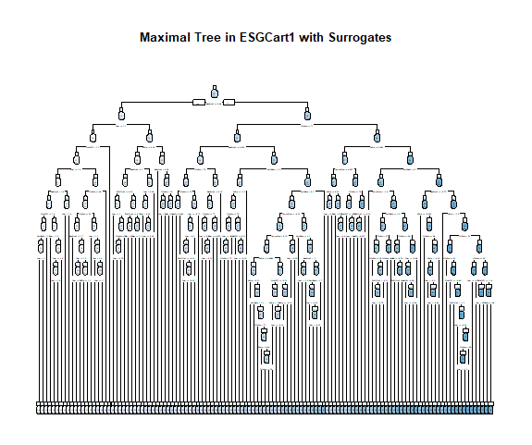
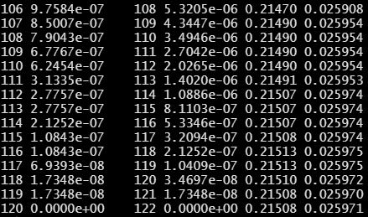
Wong Wei Jun
CART model (Null values with surrogate splits)
Maximum tree has 122 splits

Slide 42
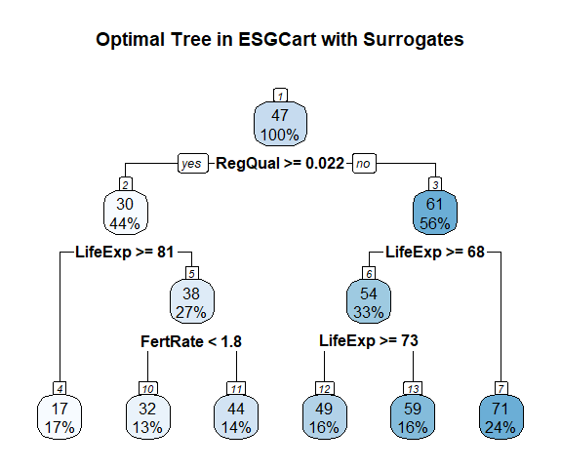
Wong Wei Jun
CART model (Null values with surrogate splits)
Decision variables are RegQual, LifeExp & FertRate

Slide 43
CART Models Evaluation
Wong Wei Jun
Testing on accuracy of CART models
Metrics | CART (Mean Value) | CART (Surrogate Split)
RMSE | 8.417404 | 9.016454
MAPE | 0.1550 / 15.50% | 0.1640 / 16.40%
CART (Mean Value) performed better than CART (Surrogate Split)
CART (Surrogate Split) contains a total of 352 null values, about 18% of the entire data set
Imputation by mean values gives a much more accurate prediction

Slide 44
SVM
Lim Qing Rui
Support Vector Machines with Linear Kernel

Slide 45
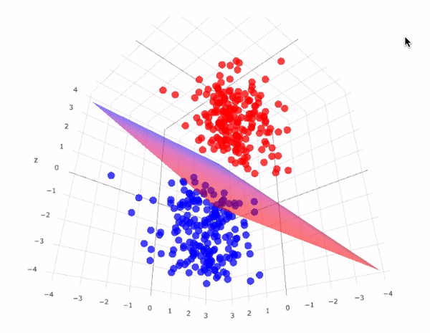
Lim Qing Rui
1
2
3
Data Visualization in hyperplane to predict dependent Variable Y
Best fit model determined through data point classification using Support Vectors
Maximizes margins of the classier data
4
5
6
Cost Function used as misclassification errors in scenario-based analysis
Data points resampled and cross-validated in Scenario based model
SVM unable to handle NA values
Image: SVM in Magnitude and Directional form
SVM Models
Non-Scenario (cost) Error analysis
Scenario (cost) Error analysis

Slide 46
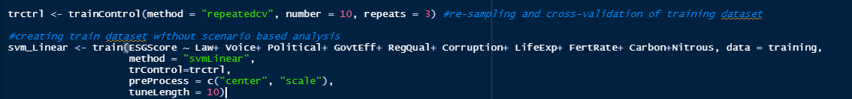
Lim Qing Rui
SVM Without Scenario/Error based analysis
1) Pre-processing step
Activate ‘caret’ Library package
set.seed(2004)
Train and test Models split according to 70-30 ratio
2) Trainset Generation
Parameter control to validate model 10 times and resample procedure 3 times
Tells algorithm to try 10 different values for main parameter ESG Score
Parsing all 10 variables into trainset model

Slide 47
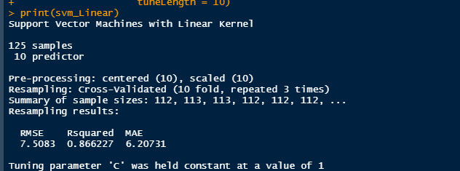
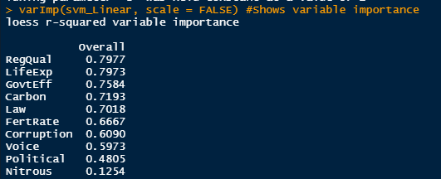
Lim Qing Rui
SVM Without Scenario/Error based analysis
Prints analysis of trainset model
3) Trainset model analysis
Statistical value of Trainset model showing high variable fit (R-squared: 0.866) and high accuracy (RMSE: 7.51)
Checks variable importance in Trainset Model
4) Variable Importance
Increasing variable importance, with RegQual showing highest weightage in model and Nitrous having lowest weightage in determining model

Slide 48
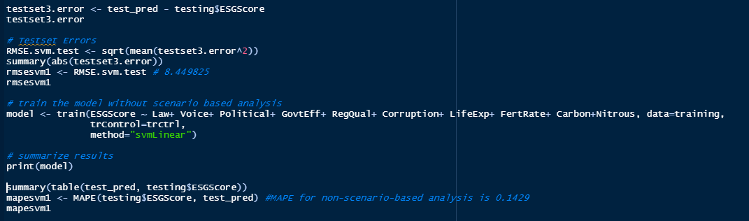
Lim Qing Rui
SVM Without Scenario/Error based analysis
Testset prediction
5) Results prediction from testset
Parse testset data into SVM Model 1 to obtain predicted results using predict() function
Plot test set results into graphical form to observe distribution (next slide)
Error and Accuracy analysis using RMSE to obtain predicted value of 8.45
6) Results analysis
Finding MAPE of results of 14.29% to show forecastability using trainset model
Notes:
First two line computes the minimum CV error + 1 SE in the maximal tree. While the middle portion are

Slide 49
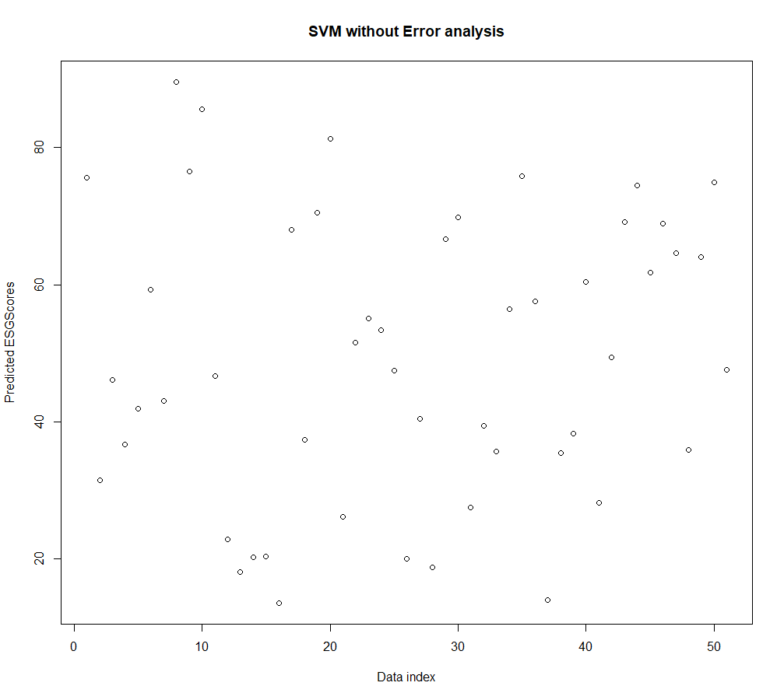
Lim Qing Rui
SVM Without Scenario/Error based analysis
SVM without scenario analysis shows equal distribution of data points for predicted results of ESG Score
Notes:
The unpruned tree results in overplotting and is undesirable as it does not show statistical significance

Slide 50
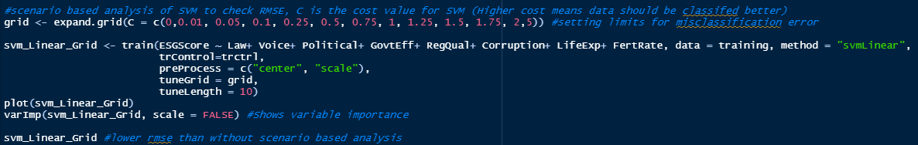
Lim Qing Rui
SVM With Scenario/Error based analysis
1) Pre-processing step
Performed in SVM without Scenario/Error Analysis
2) Trainset Generation
Setting misclassification error limits
Parameter control to validate model 10 times, resample procedure 3 times and set Error limits
Checks variable importance in Trainset Model (next slide)
Parsing all 10 variables into trainset model

Slide 51

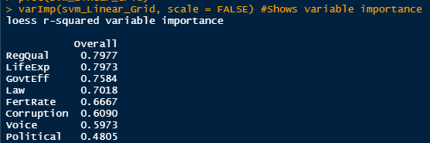
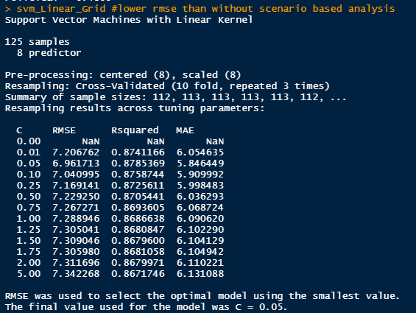
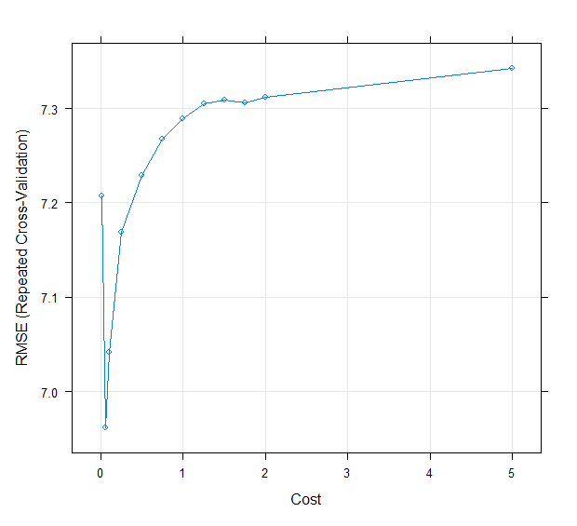
Lim Qing Rui
SVM With Scenario/Error based analysis
3) Trainset model analysis
Plots various models according to Scenarios/Errors
Statistical value of selected Trainset model showing high variable fit (R-squared: 0.878) and high accuracy (RMSE: 6.96)
4) Model plot and Variable Importance
Checks variable importance in Trainset Model
Increasing variable importance, with RegQual showing highest weightage in model and Political having lowest weightage in determining model.
Carbon and Nitrous excluded due to skewed data
Value with lowest RMSE and best model fit, used in SVM scenario analysis computation as Trainset

Slide 52
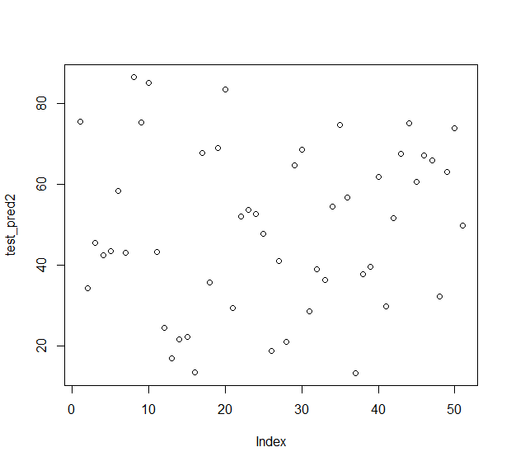
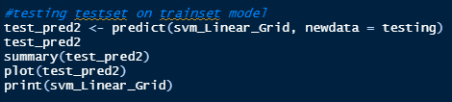
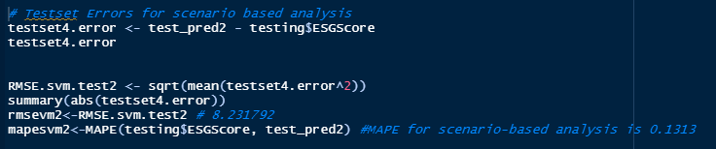
Lim Qing Rui
SVM With Scenario/Error based analysis
Testset prediction
5) Results prediction from testset
Plot test set results into graphical form to observe distribution (Right corner)
Parse testset data into SVM Model 2 to obtain predicted results using predict() function
6) Results analysis
Error and Accuracy analysis using RMSE to obtain predicted value of 8.23
Finding MAPE of results of 13.13% to show forecastability using trainset model
Notes:
First two line computes the minimum CV error + 1 SE in the maximal tree. While the middle portion are

Slide 53
Limitations of the Machine Learning Models
Lim Qing Rui

Slide 54
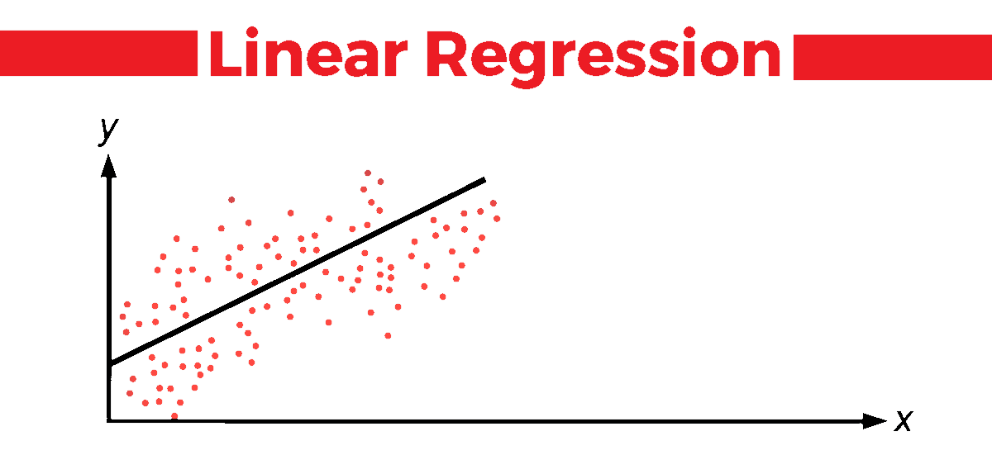
Lim Qing Rui
Linear Regression
CART
SVM
Limited to linear relationship between variables
Does not work for Categorical Y
Variables are to independent of each other
E.g Law might play a determination in CO2 emissions as countries control Carbon Dioxide emissions
Sensitive to missing data
CART with no missing values show lower RMSE than CART with surrogates
Changes to data points result in changes to optimal tree
E.g Subset at LifeExp node between models, might limit execution of country policies
Requires little NA values
Complexity of model requires several minutes to generate optimal model for Scenario based analysis
Establishing of error limits required
Hindsight bias when errors not factored in
Trade off between including errors and overfitting resulting in larger variance of errors

Slide 55
Recommendations
Lim Zi Hui
Differences between models
Variable analysis
Statistical comparisons (RMSE and MAPE)
Metrics evaluation
Model selection
55

Slide 56
Differences between Models
Lim Qing Rui
Models | RMSE | MAPE | Variable/Statistical Significance in Predicted Data
Non-Machine Learning (Mean value with region) | 13.63678 | 33.98% | NA
Linear Regression | 6.901092 | 13.81% | Variables exhibiting P-Value<0.001: Voice, Political, GovtEff, RegQual, LifeExp, Carbon, Nitrous, FertRate
CART (Mean value) | 8.417404 | 15.50% | Variable Ranking according to descending root node value: RegQual, GovtEff, Law, LifeExp, Voice, Corruption, FertRate, Carbon, Nitrous, Political
CART (Surrogate) | 9.016454 | 16.40% | Variable Ranking according to descending root node value: RegQual, LifeExp, GovtEff, Law, FertRate, Corruption, Voice, Political
SVM with Linear Kernel (Non-Error based analysis) | 8.449 | 14.29% | Variable Ranking according to descending R-Squared variable importance value: RegQual, LifeExp, GovtEff, Carbon, Law, FertRate, Corruption, Voice, Political, Nitrous
SVM with Linear Kernel (Scenario/Error based analysis) | 8.231 | 13.13% | Variable Ranking according to descending R-Squared variable importance value: RegQual, LifeExp, GovtEff, Law, FertRate, Corruption, Voice, Political

Slide 57
Lim Qing Rui
Statistical and Variable Comparison
Model | NML (Boxplot) | Linear Regression | CART (Mean) | CART (Surrogates) | SVM (Scenario analysis)
Able to show statistical quantification? | NA | YES | YES | YES | YES
Variable chosen by: | NA | Lower P-Value of predicted data | Closer proximity to root node OR If the variable is a surrogate node that has a higher value |  | Error measure in predicted and testset data
Top 4 variables (Ranked) | NA | NA | 1) RegQual 2) GovtEff 3) Law 4) LifeExp | 1) RegQual 2) LifeExp 3) GovtEff 4) Law | 1) RegQual 2) LifeExp 3) GovtEff 4) Law
Statistical comparison is not an effective comparison method as it cannot be standardised for quantification across models, but can help countries determine important variables when model is selected.

Slide 58
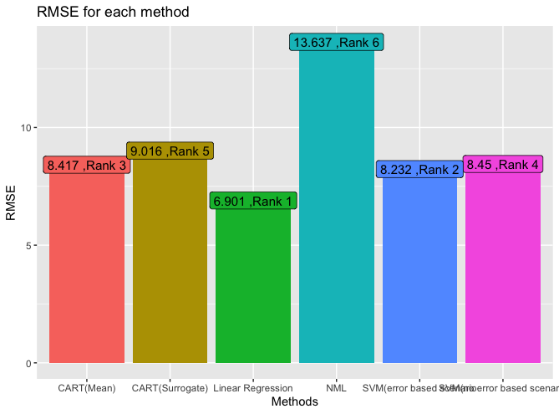
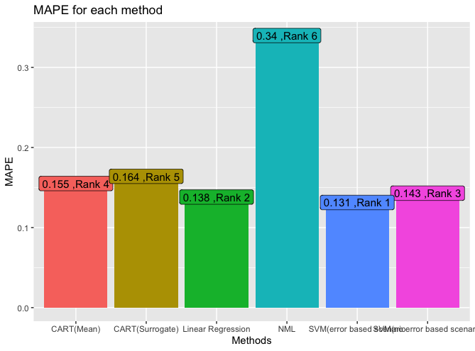
Lim Qing Rui
RMSE and MAPE Comparison
RMSE
MAPE
RMSE is high in NML, while Linear Regression shows the lowest RMSE of 6.901 showing most accuracy
Low deviation in RMSE across ML models
MAPE is highest in NML, while SVM with Error Analysis shows lowest MAPE of 13.13%

Slide 59
Lim Qing Rui
Metrics Evaluation
RMSE
MAPE
MAPE puts heavier penalty on negative errors due to percentage error, resulting in biases if model has low data values
Higher MAPE when predicted value is lower than actual value
MAPE can show model overfit through high MAPE values
RMSE indicates errors between testset and predicted results, lower value better
Standardised unit of measure

Slide 60
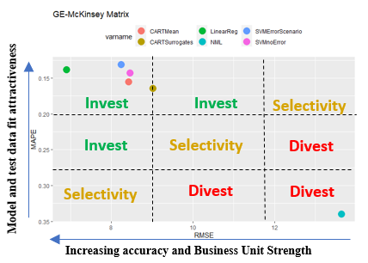
Lim Qing Rui
Model Selection
Linear Regression on efficient frontier of GE Matrix
Machine learning models exhibit high investment potential in predictability of results
Non-Machine Learning models show low indication in feasibility (large residual errors present)
Pivot towards Machine learning models for prediction of ESG using ML models such as Linear Regression

Slide 61
Conclusion
Lim Zi Hui
Machine Learning Models as a superior tool for analysis and visualization
61

Slide 62


Lim Qing Rui
Multimodal Predictive Analytics and Machine Learning Solutions helping to make better predictions about business processes and operations
Artificial Intelligence and Machine Learning in forecasting economic factors such as GDP proven to be more accurate than conventional statistical methods
Creation of new business line and product for ESG Reports
Serve underutilized market segment for ESG Product needs
Enhance current products and predictive models
Help countries strategize and develop plans to attract investors
Expand target market through accurate forecasts and deeper analysis of variables through timely forecasts and mitigations using Machine Learning Models

Slide 63
Thank You!

